Slide 1
Micro services

Slide 2
What are microservices
Definitions and History
Considering microservices
Pros & Cons
building microservices
Patterns, Practices & Guidelines
Practice
Task management system refactoring

Slide 3
What are microservices

Slide 4
Conext
Response to new approach:
Agile methods
DevOps culture
Cloud
Linux containers
adoption (culturally and technically) of CI/CD

Slide 5
In short, the microservice architectural style is an approach to developing a single application as a suite of small services, each running in its own process and communicating with lightweight mechanisms, often an HTTP resource API. These services are built around business capabilities and independently deployable by fully automated deployment machinery. There is a bare minimum of centralized management of these services, which may be written in different programming languages and use different data storage technologies.
-- James Lewis and Martin Fowler

Slide 6
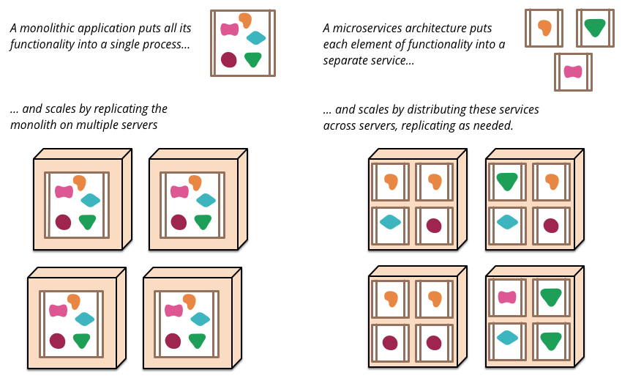

Slide 7
Characteristics
language-, platform-, and operating system-agnostic
built by a full-stack team
Domain-Driven Design
Single Responsibility Principle
independent DURS (Deploy, Update, Replace, Scale)

Slide 8
What about soa?
SOA > Microservices

Slide 9
Considering microservices

Slide 10
Pros
cons
Independecy
Easy maintainable
Heterogeneity & polyglotism
Imporoved communication
Distribution PERFORMANCE / RELIABILITY
Eventual consistency ACID / CAP
Operational complexity

Slide 11

HOW „MICRO” SHOULD IT BE?

Slide 12
Requirements
SERVICE REPLICATION OPENSHIFT, DOKER
SERVICE DISCOVERY ZOOKEEPER / ETCD / CONSUL / KUBERNETES / EUREKA
SERVICE MONITORING ELASTICSEARCH / FLUENTD / KIBANA
RESILIENCY HYSTRIX
DEVOPS CI/CD / JENKINS / BAMBOO / TFS / TEAM CITY

Slide 13
Building microservices

Slide 14
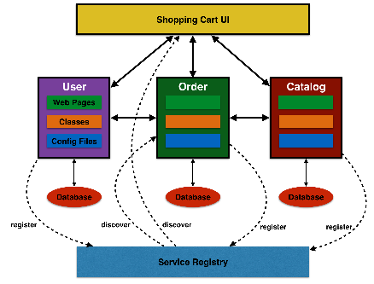
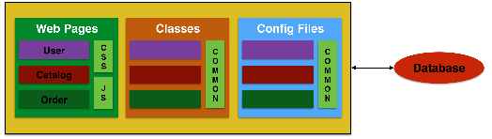
Refactoring to microserviceS
Monolithic architecture
Microservices architecture

Slide 15
Microservices design patterns
USE BOUNDED CONTEXTS TO IDENTIFY CANDIDATES FOR MICROSERVICES
DESIGNING FRONTENDS FOR MICROSERVICES
USE API GATEWAY TO CENTRALIZE ACCESS TO MICROSERVICES
DATABASE DESIGN AND REFACTORINGS
EVENT-DRIVEN ARCHITECTURE

Slide 16
Refactoring Principles
Separate your concerns
Convention over Configuration
Follow the Law of Demeter
Use Domain-Driven Design
Focus on Automation
Design to Interfaces / APIs-
Group code by functionality, not by layer

Slide 17
PRACTICE

Slide 20
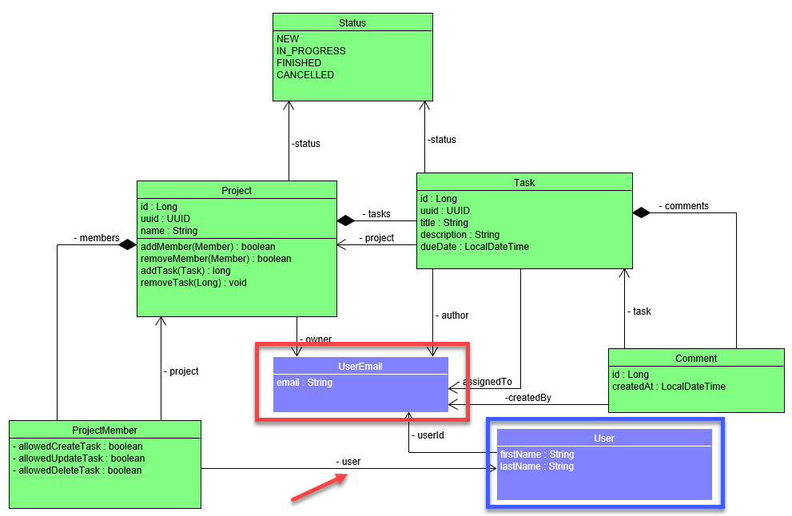

Slide 21
Resources
Microservices Resource Guide - https://martinfowler.com/microservices/#what
DZone refcardz – „Getting started with Microservices”
DZone refcardz – „Microservices in Java”
Sam Newman, OReilly – „Building Microservices”
Chris Richardson, Manning – „Microservices Patterns – With examples in Java”

Slide 22
EXTRAS
Martin Fowler, „Microservices” – https://www.youtube.com/watch?v=wgdBVIX9ifA
Chaos Monkey – https://netflix.github.io/chaosmonkey/

Slide 23
Thank you

